Slide 1
Outcomes of Research-Based Learning in the Curriculum
UWA Teaching Excellence Conference 2019
Dr John Willison
University of Adelaide
john.willison@adelaide.edu.au
Fluid thinking

Slide 2
Overview
Start with some outcomes across courses and degrees
Then look at how we got there
Framework
Implementation
Finally, things learned about the term ‘research’
MELT (Models of Engaged Learning and Teaching
Making connections across the degree

Slide 3
Medical Science, with Explicit development and assessment in Years 1 and 4
“Since the beginning [of First Year], they have given us assignments based on this criteria. You might not have liked the assignments, but because they have been consistently applying this structure to all of our assignments, we have come to think that way for science, in the perspective of science and writing …” (Willison & Buisman-Pijlman, 2016 p.75-76)

Slide 4
Interviews one year after completion with B. Media graduates who experienced explicit research skill development and assessment in several courses
“... eventually it becomes not just autonomous learning but a questioning of the process and system itself, where you can actually review your own process of learning or system of whatever you’re doing, so you can actually change it and improve it. I think that’s something which is going to be really important for me in my career going forward.”
(Wilmore & Willison, 2016 p.10)

Slide 5
Before I left for Cambodia, I actually took a silver fluoride which is a product that we didn’t even actually come into contact with in the Bachelor of Oral Health… because it stains teeth and there’s all these things that they don’t like aesthetically so that’s why we weren’t using it. ..
Willison, Zhu, Xie, Yu,, Chen, Zhang, Shashoug & Sabir, (Under review)

Slide 6
Continued
… But it’s like an amazing product because I thought that might be really beneficial for Cambodia because they don’t get care often and they’re considered more rural… I ended up purchasing some [silver flouride] and taking it over with me and I was using it a lot when I was over there (Graduate A).

Slide 8
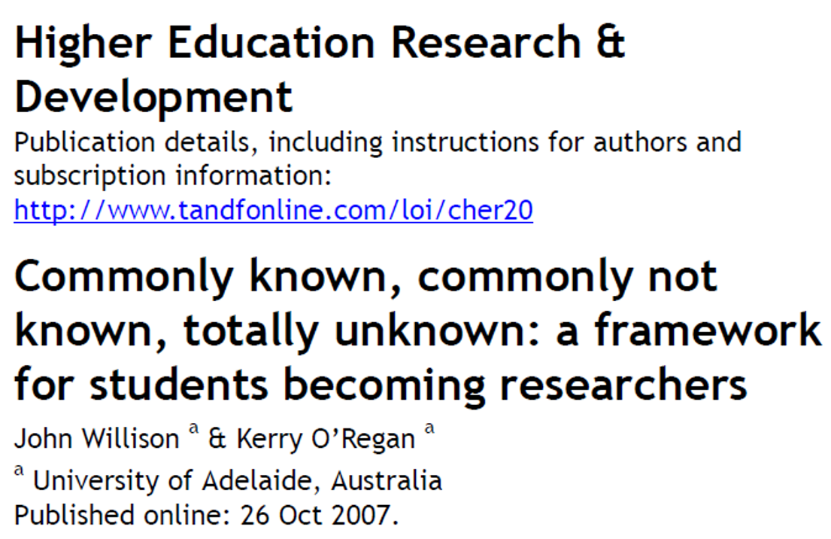
Research Skill Development framework

Slide 10
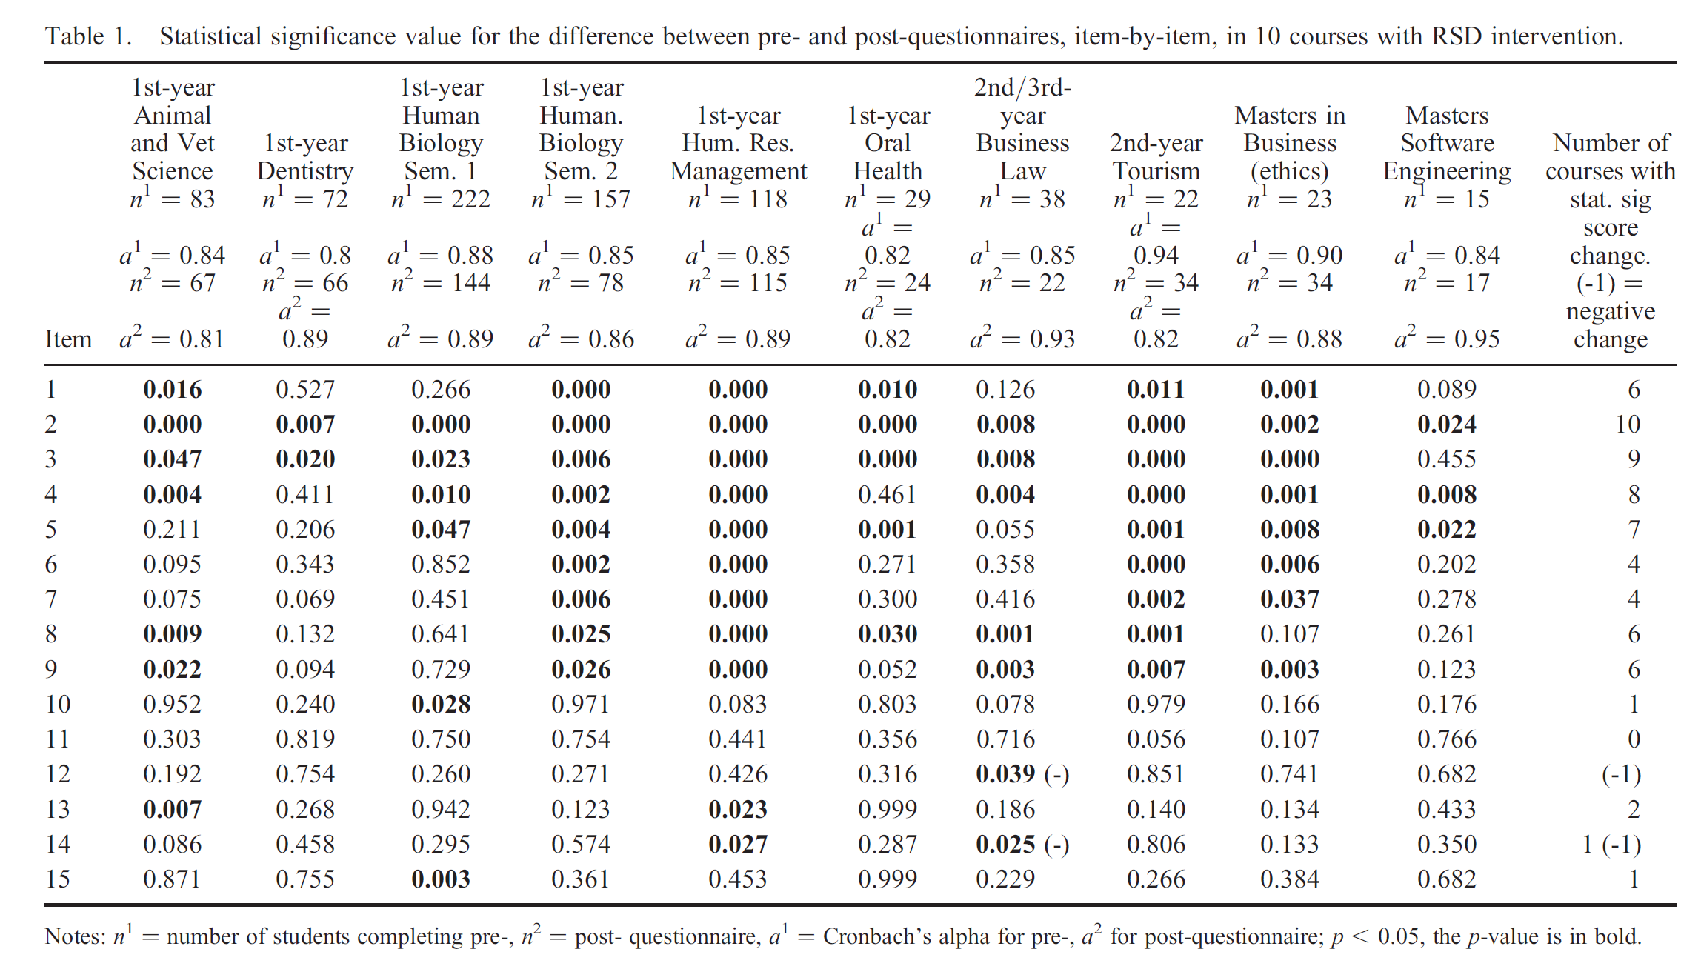
Research skills could be developed in content-rich courses
Research skills were at risk of atrophying if they were not subsequently explicitly developed.

Slide 11
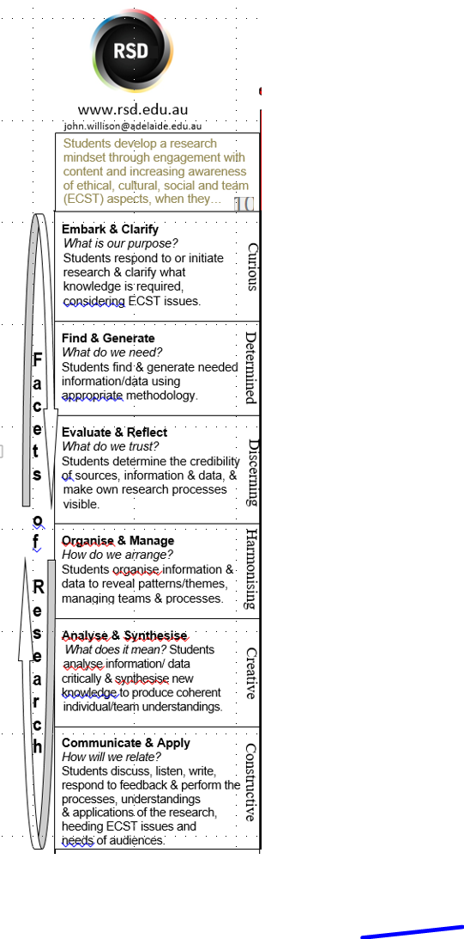
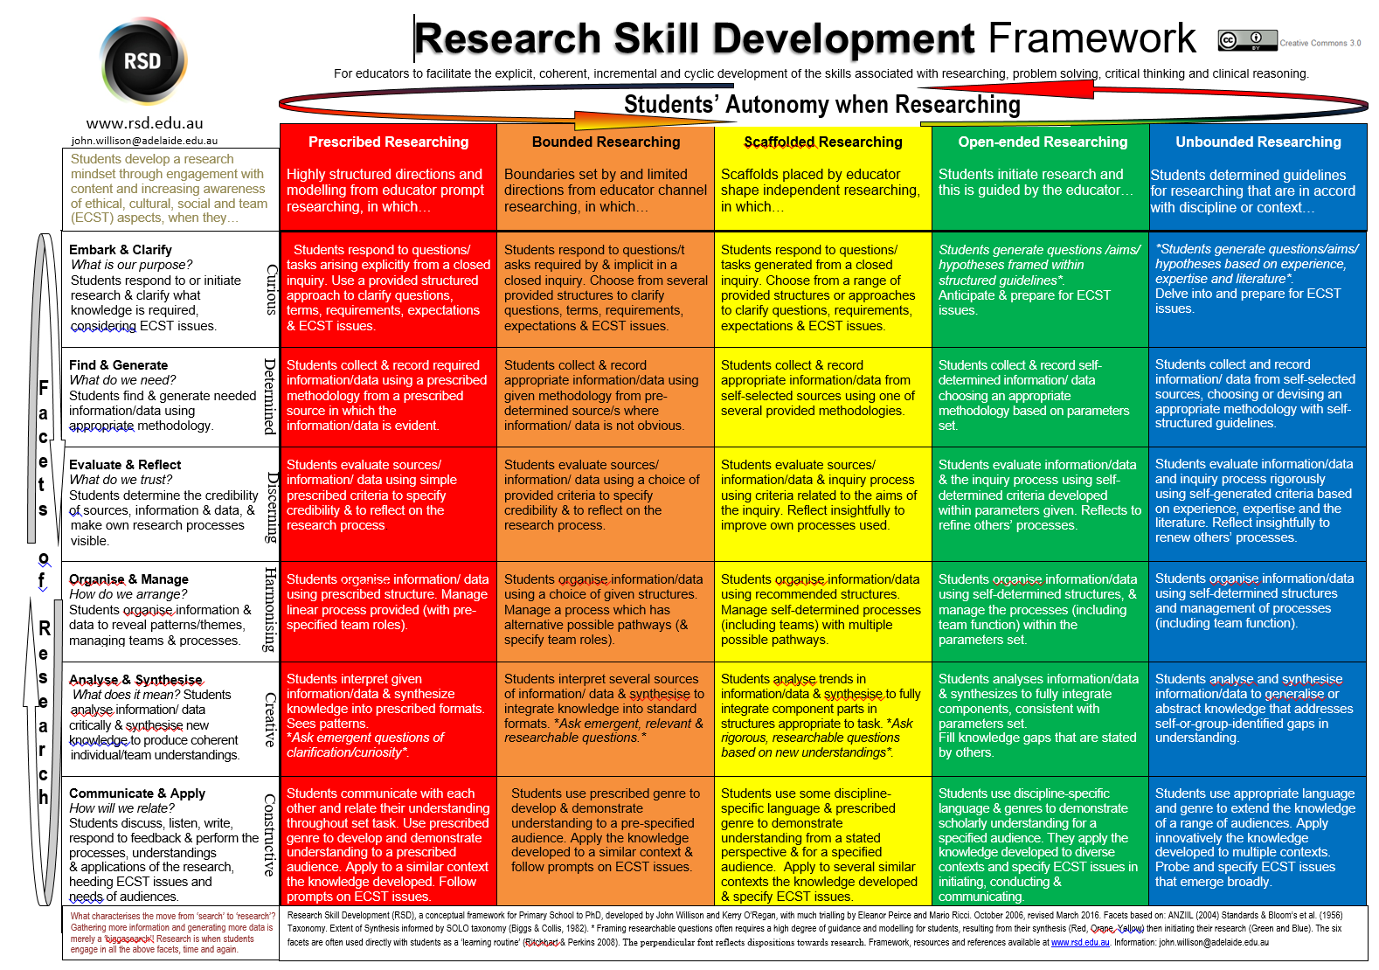
Embark and Clarify
Find and Generate
Evaluate and Reflect
Organise and Manage
Analyse and Synthesise
Communicate and Apply
Facets are based on:
Information literacy standards
Blooms taxonomy
Good practice
Much piloting and redrafting

Slide 12
Extent of Autonomy based on
Vygotsky’s Zone of Proximal Development
Close to open inquiry
Model, scaffold, fade
SOLO taxonomy
Emulate Improvise Initiate

Slide 15
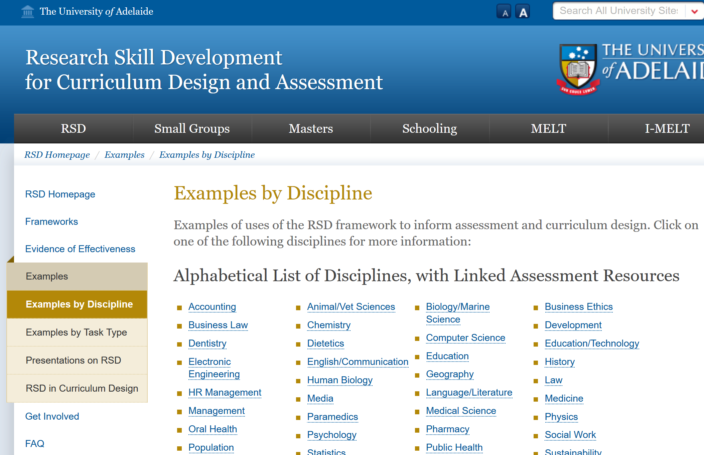

Slide 16
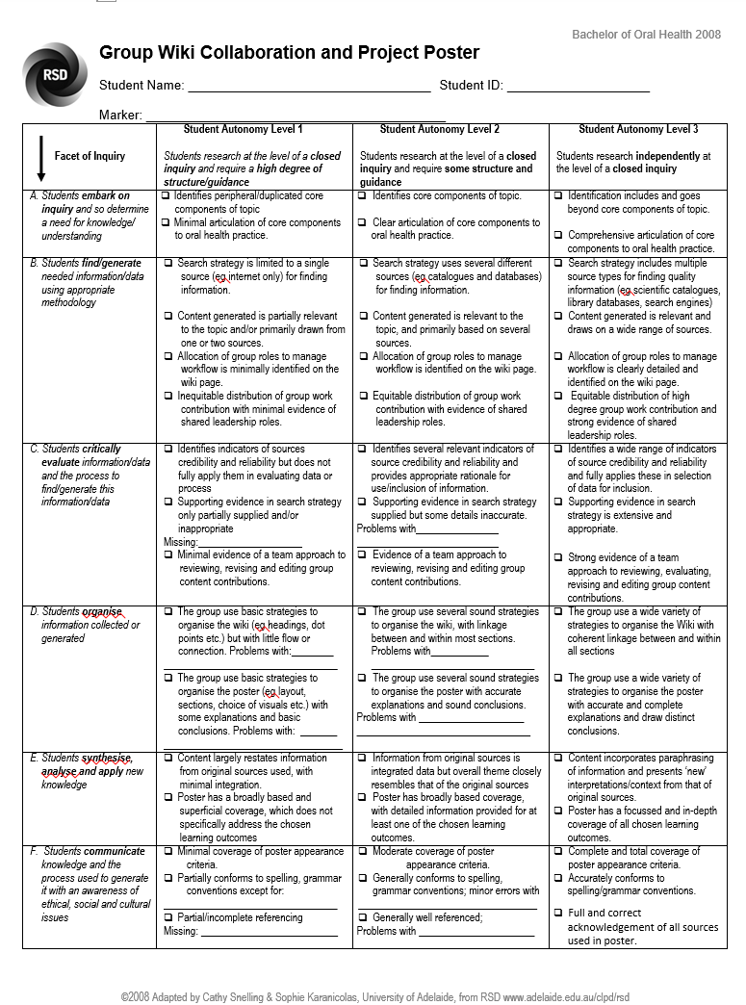

Slide 17
Process.. from graduates’ perspective
Well, I guess there’s always some sense of trepidation... they were scaling up from assisting us and then giving us more autonomy as we went (Graduate D).

Slide 18
Process.. from graduates’ perspective
… towards the end of the degree, I saw that they started to get it. It just sort of clicked to them. But initially it was really hard, and also their academic writing, they just didn't understand. (Graduate I).

Slide 19
Process.. from graduates’ perspective
You have to research it, you don’t get fed stuff anymore. You have to go, research it, sit down, analyse what’s important and what’s not. So yes, it slowly did lead up to a better research in third year. I think if we started researching in third year, we wouldn’t produce a high quality piece of work at all (Graduate B).

Slide 20
Process from Graduates’ perspective
I think maybe one of the biggest things would be making students more aware of the research skills when they’re doing the assignments, so things like the (First Semester] General Studies course and that sort of thing, that is teaching them the skills and why you do it, and that kind of thing (Graduate F).

Slide 21
Outcomes, from graduates’ perspective
… it encourages all its graduates to have a mindset of research on focused learning, lifelong learning and to know that study doesn’t stop at the end of the course… (Graduate D).

Slide 22
Without a common framing …
Looking back at my undergrad, I sort of didn’t really have much to do with this framework in the large scheme of things. It was more sort of focus on whatever assignments you had at the time and not really looking at the big picture.
Animal Science Honours Student
(Willison, 2014)

Slide 23
Lots of individual trees….
‘… given the growth of ever more detailed marking schemes for assessments, does feedback become something which is too specific to a single episode of assessment rather than generalisable to the learning experience as a whole’
(Adcroft, 2011 p. 417).

Slide 24
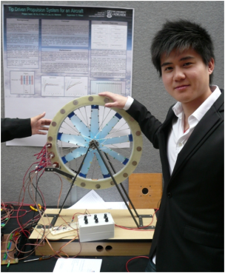
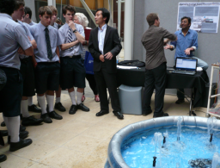
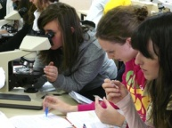
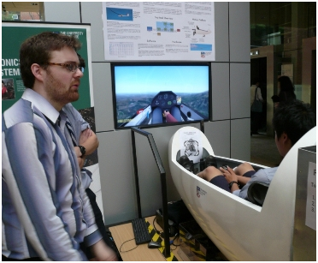
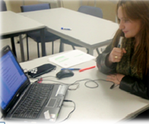
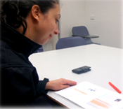
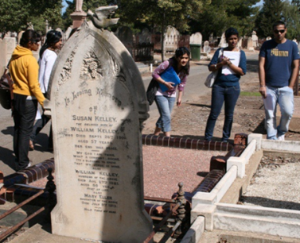
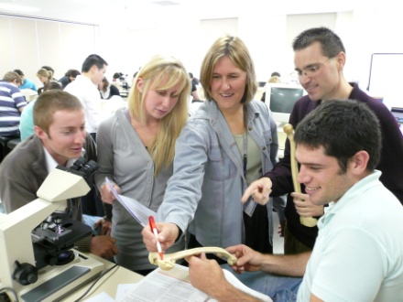
Connecting Thinking Skills
Subject by Subject across the degree
Variety, nuances
Coherent, flexible spine

Slide 25
Facets of sophisticated thinking
Progressive revisiting the same skill set:
in varying contexts
with increasing degrees of rigour, conceptual demand
can become a thinking routine (Ritchhard and Perkins, 2008)
Embark clarify Find generate Evaluate reflect Organise manage Analyse synthesise Communicate apply
Embark Generate Evaluate Organise Synthesize Communicate
Embark clarify Find generate Evaluate reflect Organise manage Analyse synthesise Communicate apply
Embark clarify Find generate Evaluate reflect Organise manage Analyse synthesise Communicate apply

Slide 26
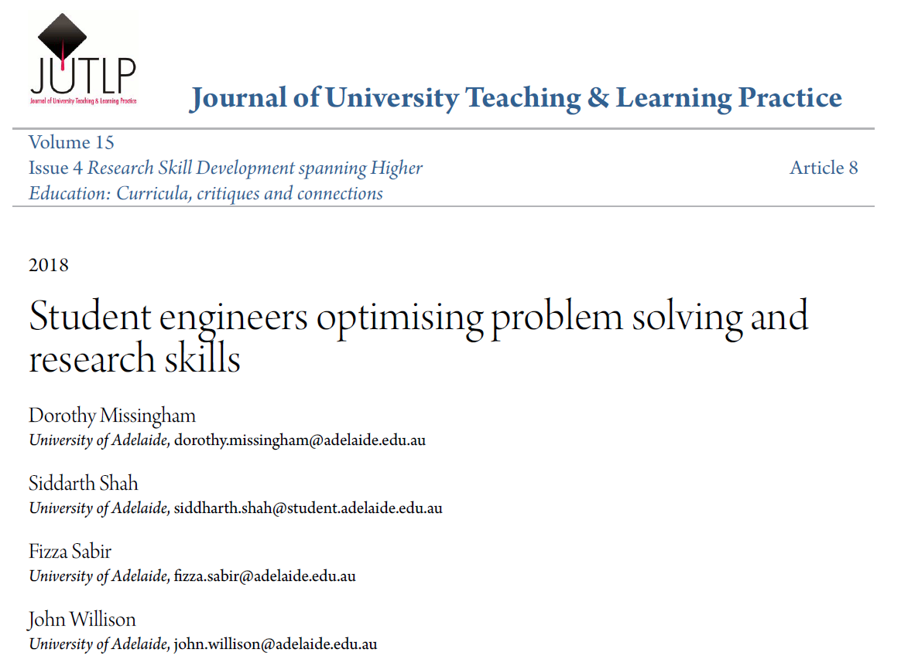

Slide 27
Optimising Problem Solving pentagon
When in doubt, go to the centre…
Generate & Reflect
Communicate & Apply
Find & Evaluate
Define problems and specifications
Organise & Manage
Analyse & Synthesise
Based on www.rsd.edu.au and OPS designed by Mechanical Engineering Communications Tutors, University of Adelaide, 2014
john.willison@adelaide.edu.au

Slide 28
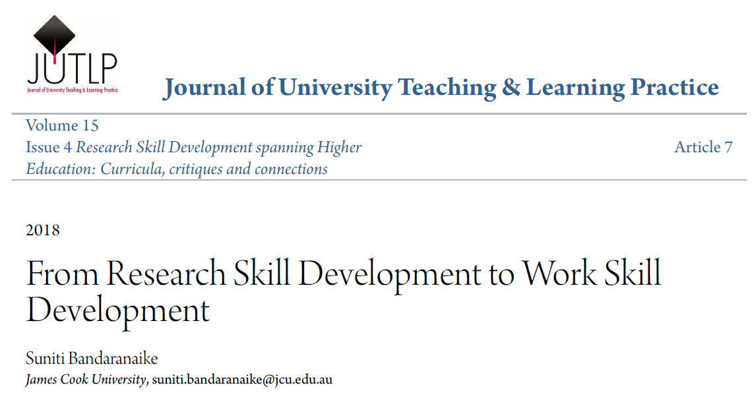

Slide 29
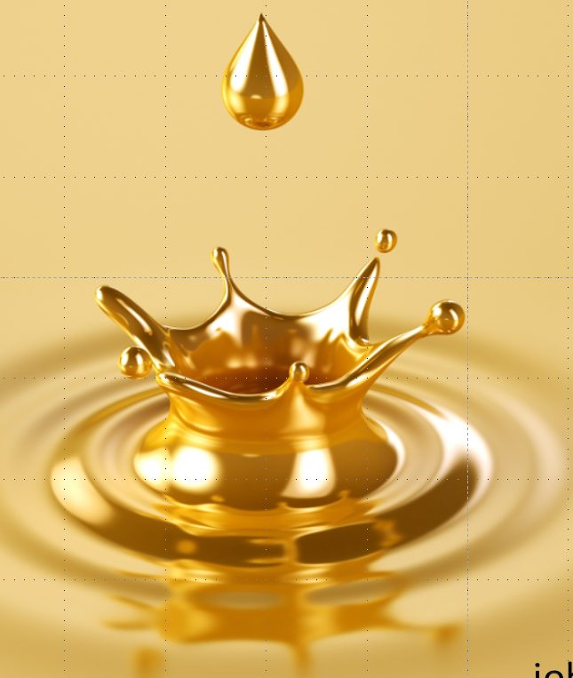
Models of Engaged Learning and Teaching

Slide 30
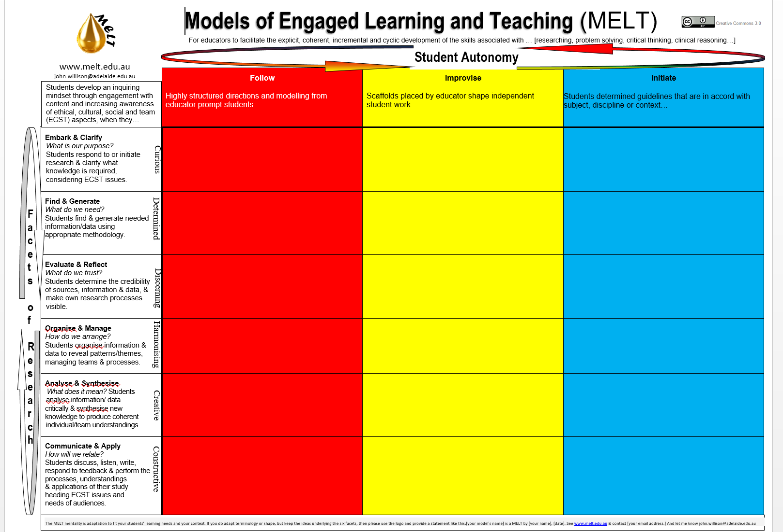

Slide 31
Connections between research as a process and clinical reasoning
So the way that you have to think about it when you research is that the first thing you would think when you would see them [patients] as a clinician. They [patients] provide you with a brief summary, and you have to think about their background. First off, that’s how you think as a clinician – the background, all their history, so socially, dentally, medically (Graduate G).

Slide 32
Models of Engaged Learning & Teaching
When in doubt, go to the centre…
Communicate & Apply
How do we relate?
What does it mean?
Embark & Clarify
Analyse & Construct
Find & Generate
What will we use?
What is our purpose?
Evaluate & Reflect
Organise & Manage
How do we arrange?
What should we trust?

Slide 33
Tomorrow’s Workshop 9am

Slide 34
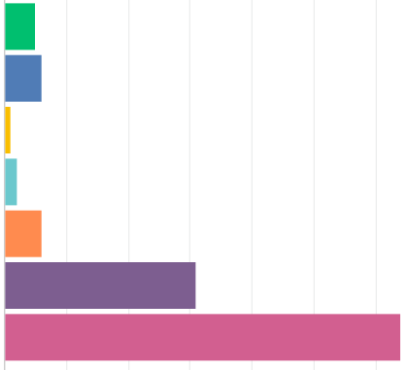
The six facets of MELT do broadly address the thinking skills used when researching, problem solving, critical thinking, evidence based decision making, etc (Survey Monkey: response 115/240 attendees)
4% Strongly disagreed
5% Moderately disagreed
82% Moderately or Strongly agreed
27% Moderately agreed
56% Strongly agreed

Slide 35
Engagement

Slide 36
MELT
Fluid thinking
Connections
Sensible conversations

Slide 37
Thankyou!
UWA Teaching Excellence Conference 2019
Dr John Willison
University of Adelaide
john.willison@adelaide.edu.au
Fluid thinking

Slide 38
Critical Thinking pentagon?
When in doubt, go to the centre…
Evaluate & reflect
Based on www.rsd.edu.au and OPS designed by Mechanical Engineering Communications Tutors, University of Adelaide, 2014
john.willison@adelaide.edu.au

Slide 39
Medical Science, with Explicit development and assessment in Years 1 and 4
“I always remember these [RSD-framed] marking criteria sheets, but I think if they were emphasised more and you know that they kind of reinforce these facets a little more strongly throughout every year, it would be really, really good, I reckon.”
(Willison & Buisman-Pijlman, 2016 p.75-76)

Slide 40
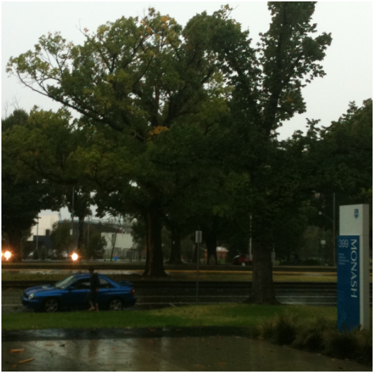
1. Stimulus for Electrical Engineering 4th Year Undergrads

Slide 41
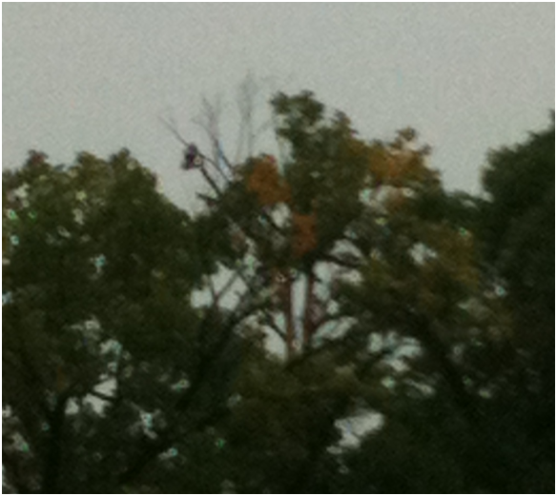

Slide 42
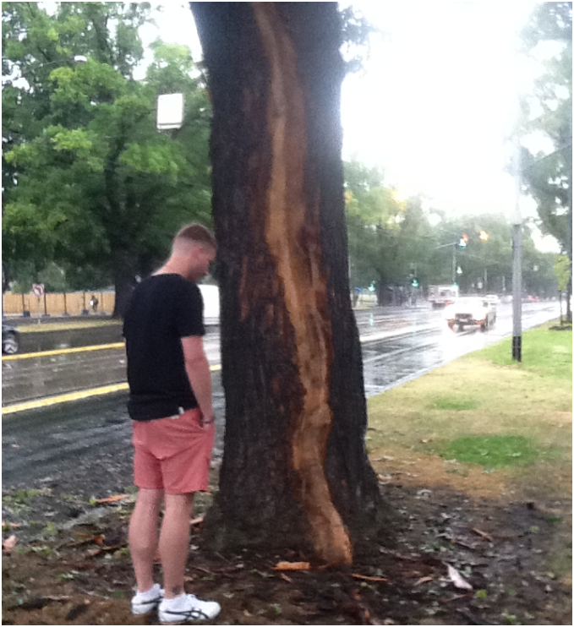

Slide 43
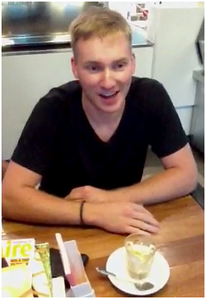
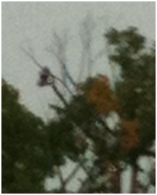
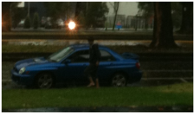

Slide 44
‘Lightning never strikes twice in the same place’
Reasons why this adage may be true | Reasons why this adage may be wrong

Slide 45
Stimulus for Nursing Students
‘Right now I’m still
overwhelmed. A tingling sensation throughout my whole body.’

Slide 46
Should Dom have gone to Emergency?
Reasons why Dom should have gone to emergency | Reasons why Dom need not have gone to emergency

Slide 47
Identifying specifications and constraints
You are part of a team of six engineers who have been hired by a Non-Government Organisation (NGO) to design and manufacture durable, cost effective beds for use in a camp. This camp is located in Nepal as a consequence of recent earthquakes.
You are expected to define the specifications and constraints that meet the needs of all the stakeholders.

Slide 48
Your Problem Solving Skills
Specifications | Constraints
Cheap Durable Long Lasting Small mass Able to support average person mass Inclusive of Bedding Inclusive of Pillow Long enough for tall people Easily transported Waterproof Comfortable Easily Storable Elevated Easily constructed Earthquake-proof Stackable Ergonomic Environmentally friendly Color Shock absorbent Insulated Foldable Lightweight Easily deployed | Cost Material Weight Type of bed Permanency Locality of materials Allergies Time to manufacture Easily cleaned Transportable Time to deploy Insulation Safe Size (Folded and unfolded) # of beds required Sanitation
design and manufacture durable, cost effective beds for use in the camp. This camp is located in Nepal as a consequence of recent earthquakes.
Group with the highest number of each category reads them out.
You have 3 minutes

Slide 49
What skills did you use to do that?
OPS Facets | Your Analysis
A. Define & Specify problem | Empathy , planned- who would be decomposing- focussed on whats most important, brainstorm
B. Find & Reflect | Foresight- thinking ahead- what it might look like; related to something I have seen before, went to prob statement, comparison
C. Generate & Evaluate
D. Organise & Manage | List the things that a bed needs- dot points- categorising
E. Analyse & Synthesise | critical thinking, empathetic reasoning, decision making,
F. Communicate & apply | Argumentative discussion , listened- nodded head- provide feedback- took notes eye contact

Slide 50
MELT
THANKS for coming!
Dr John Willison
School of Education
University of Adelaide
Dr Sue Bandaranaike
James Cook University
Supported by the Department of Education and Training, Australian Government
Fluid Thinking

Slide 51
Critical Thinking and Researching
Similarities | Differences
Analytic skills Can be done in groups (or social phenomenon to go to higher levels) Can be done individually Pretentious wanky terms Difficult to teach Systematic Requires understanding the method of communication of others Understand background Active Challenging established knowledge/norms Synthesis of knowledge Used to answer questions/ask questions Used to question assumptions Need to be presented (CT) Reflective Evidence based Justification of beliefs | Research – more open ended Research is expansive, critical thinking is focused Research is macro, critical thinking is micro Critical thinking is a component of research Research has many other components Critical thinking can be seen as more open Research more focused on an endpoint (integral activities) Timeframe – critical thinking is more immediate (disposition), research longer term Research – specific/ critical thinking – general Research has a more established method, critical thinking is not nec. Tied to a single method. Critical thinking – no particular output required

Slide 52
…they did try to make us use the knowledge and apply it to the clinical environment…but maybe that’s something that could have been focused on a little bit more.…unless you have somebody or a moment where they tell you that you need to apply it, or even if we were in the clinical situation and your tutors were able to say to you, this is like what we did in this assignment, this is where we’re using this (Graduate F).

